Slide 1



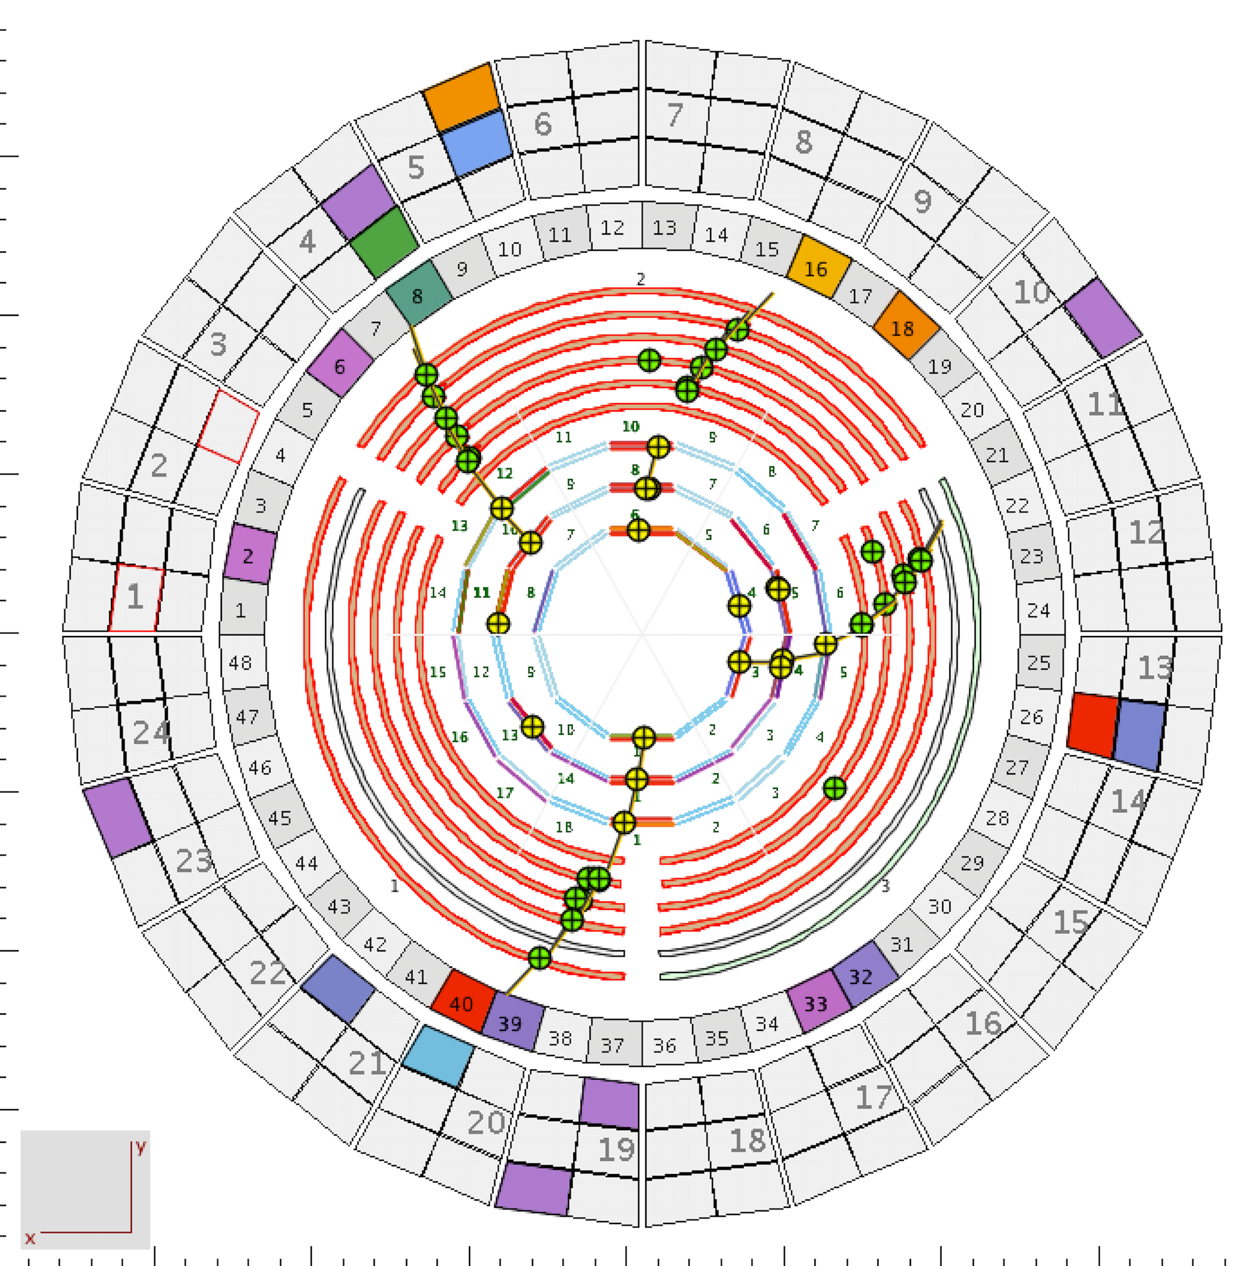
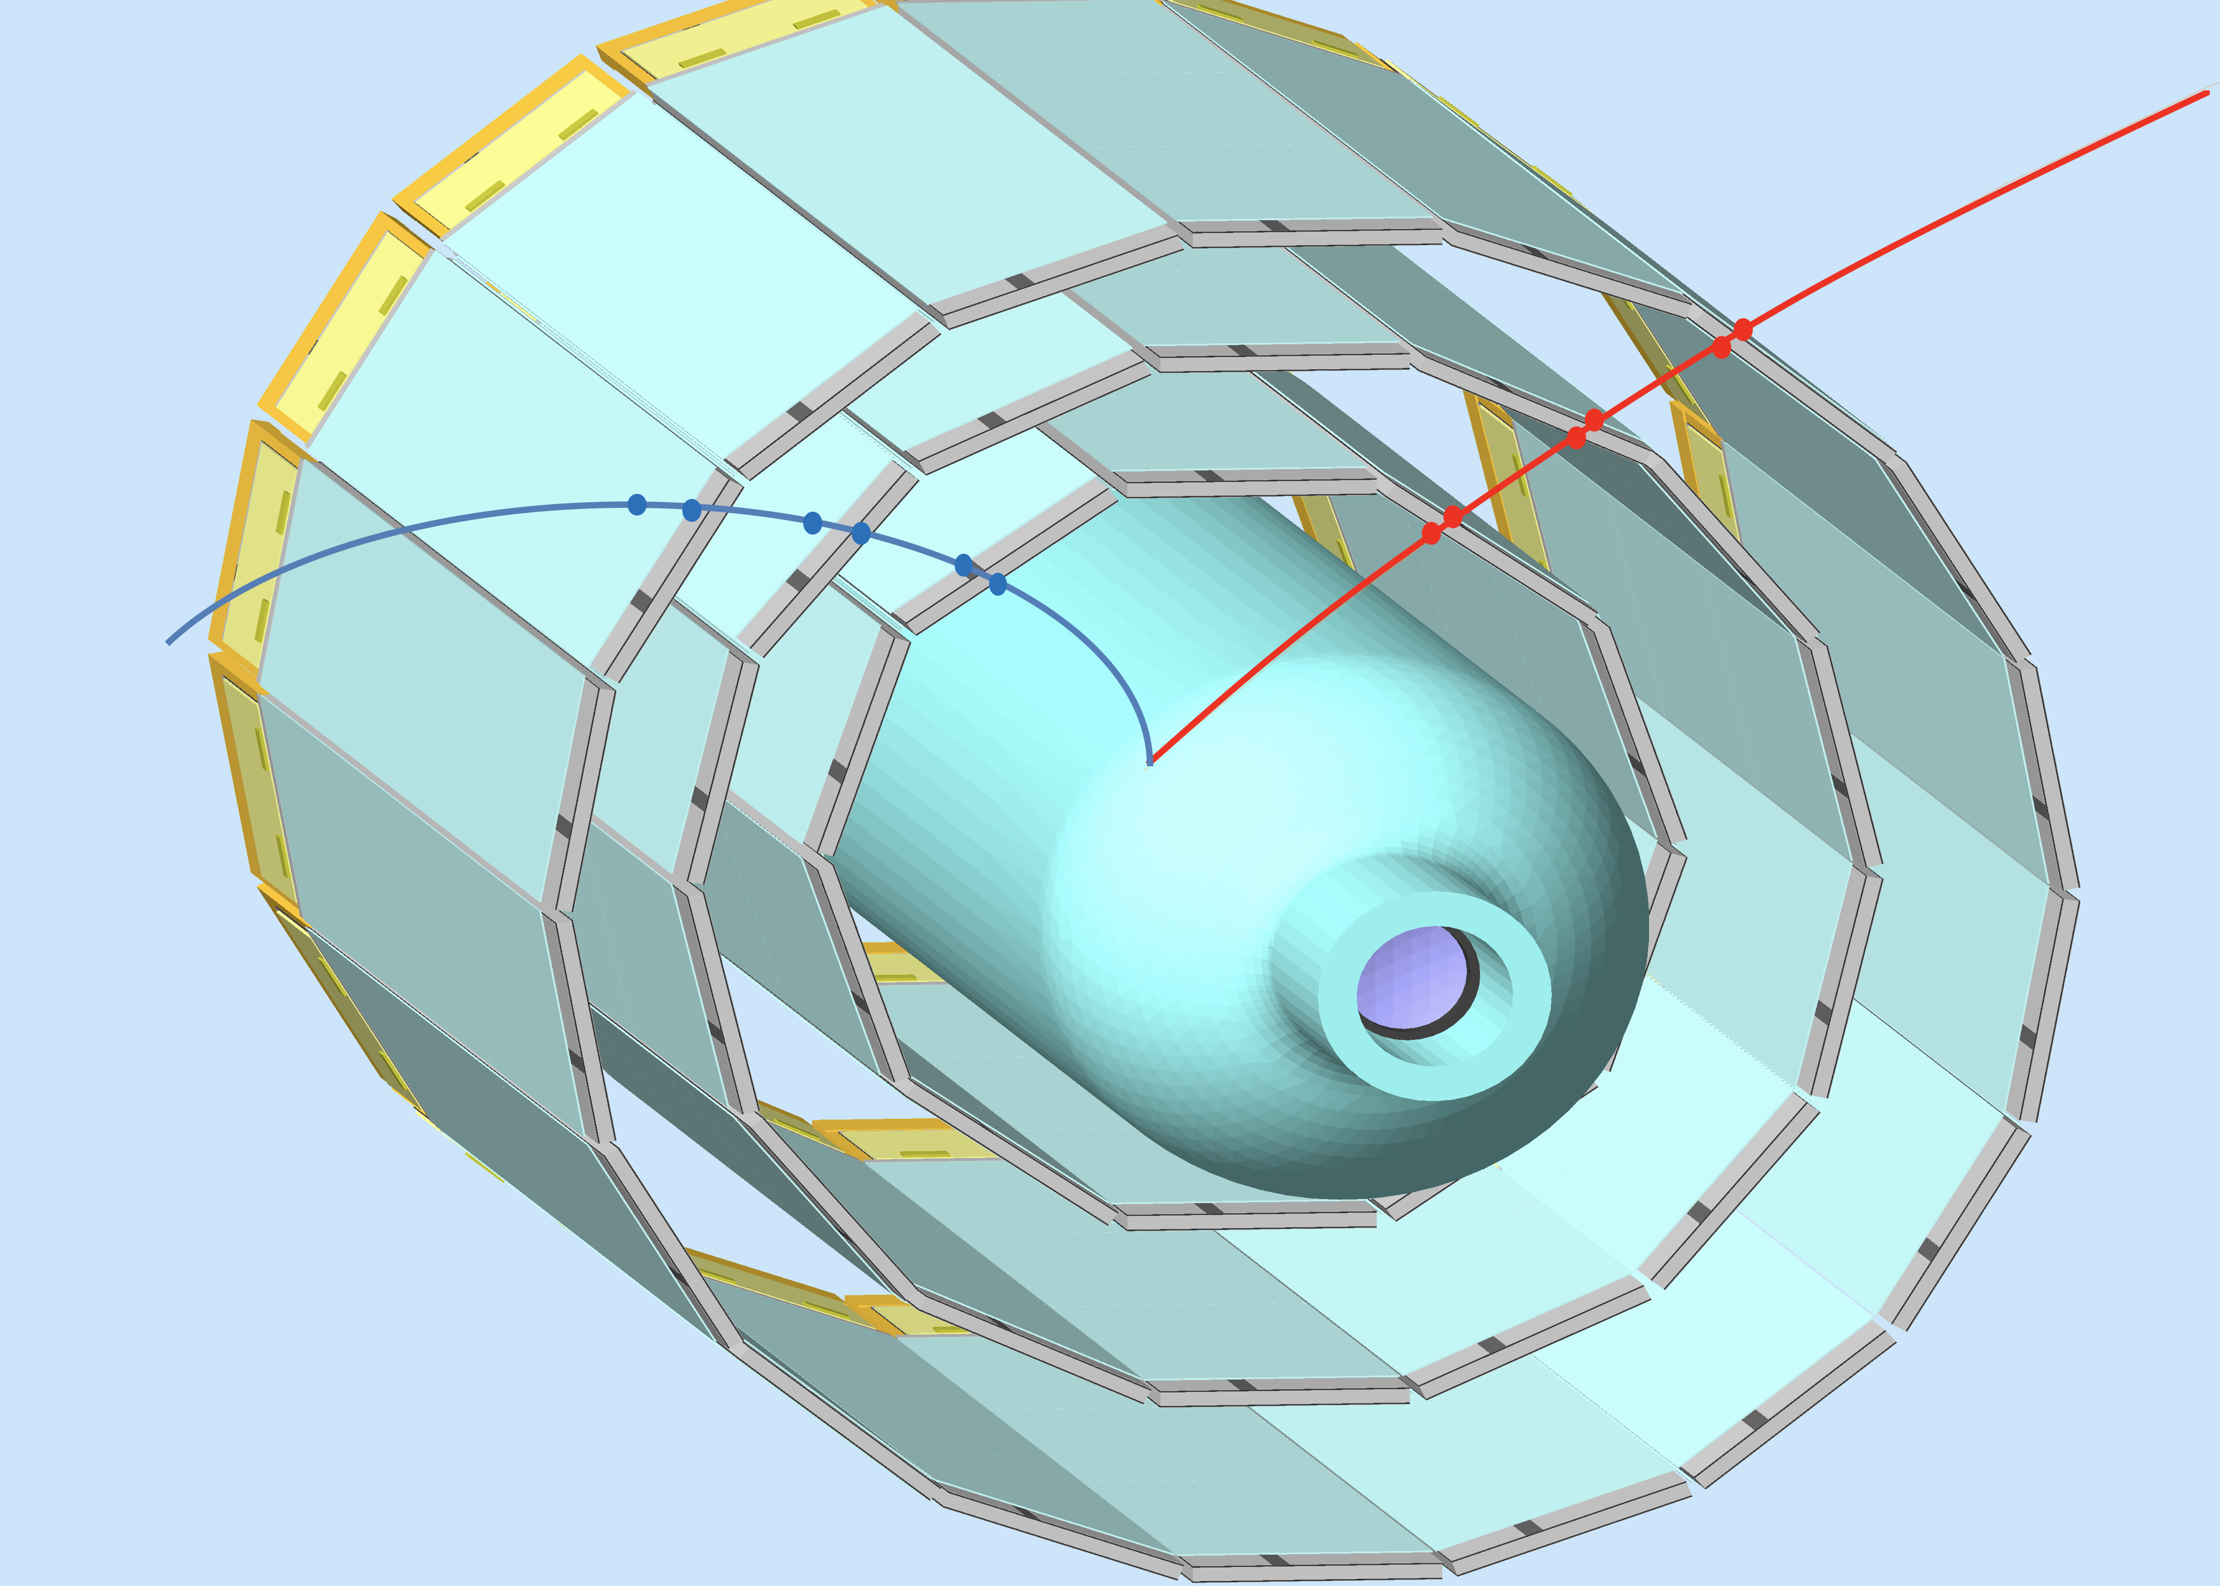
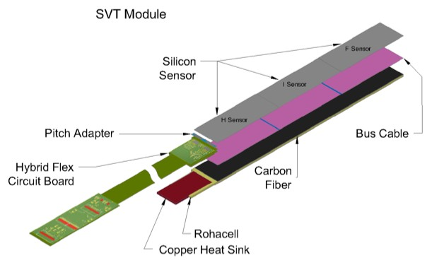
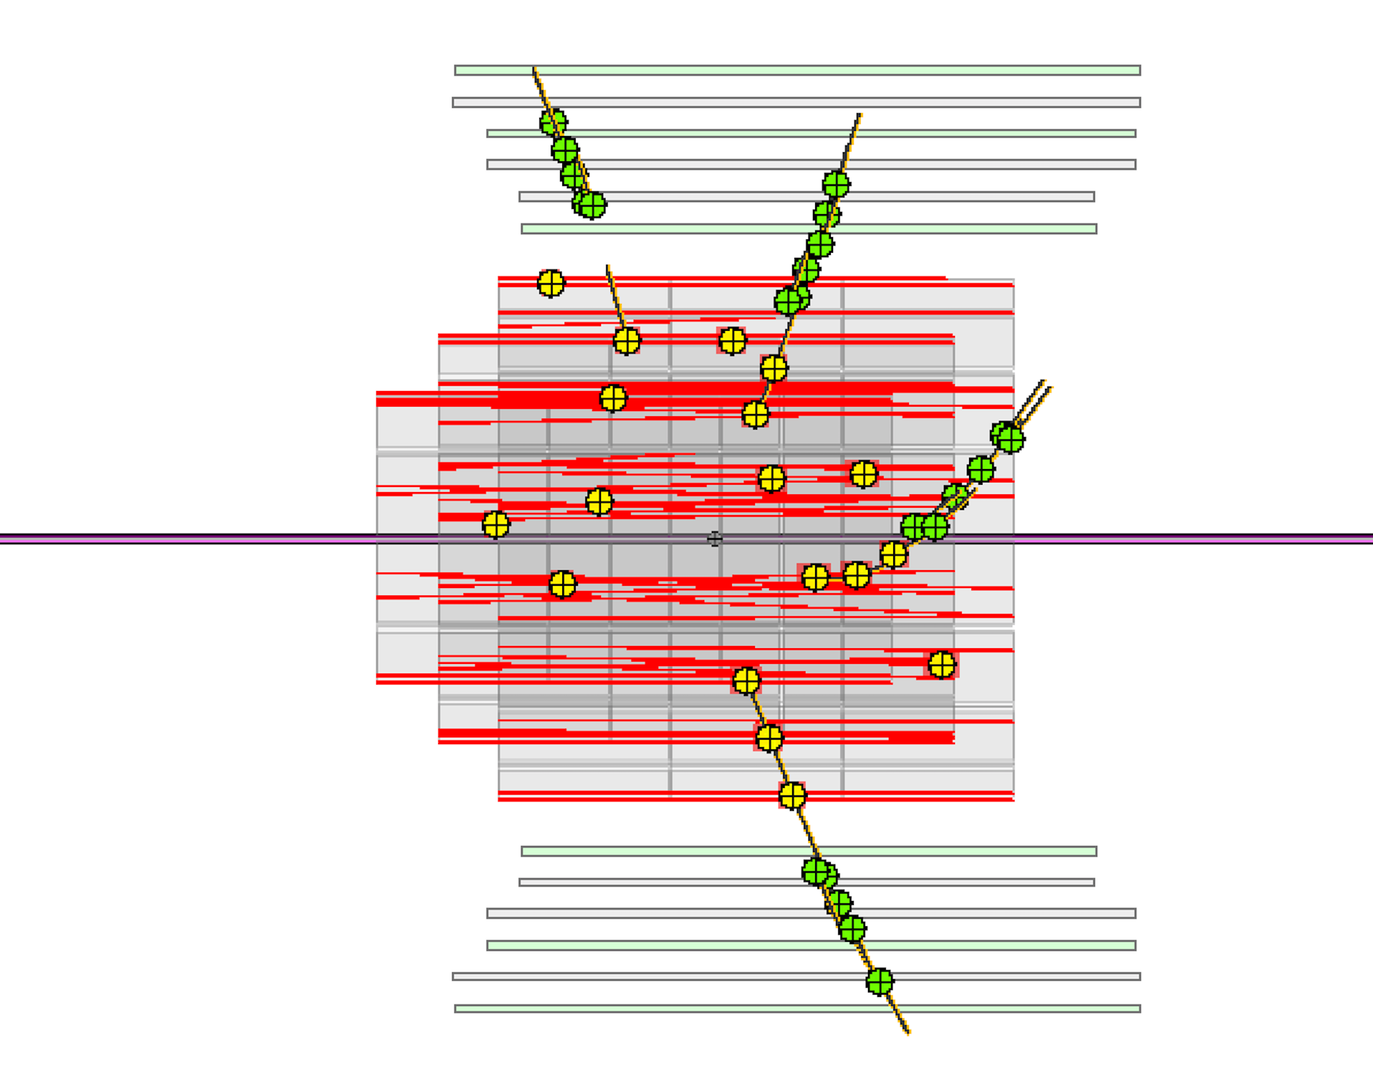
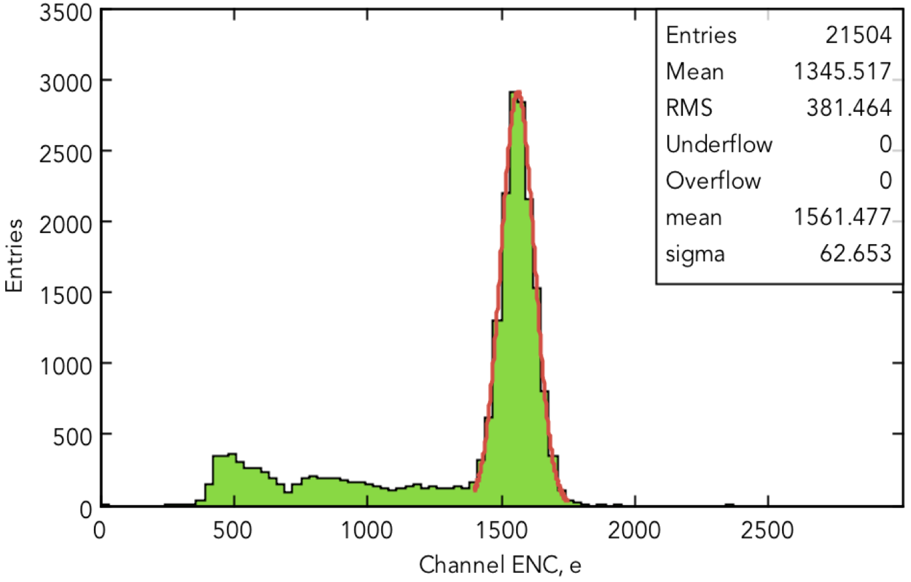
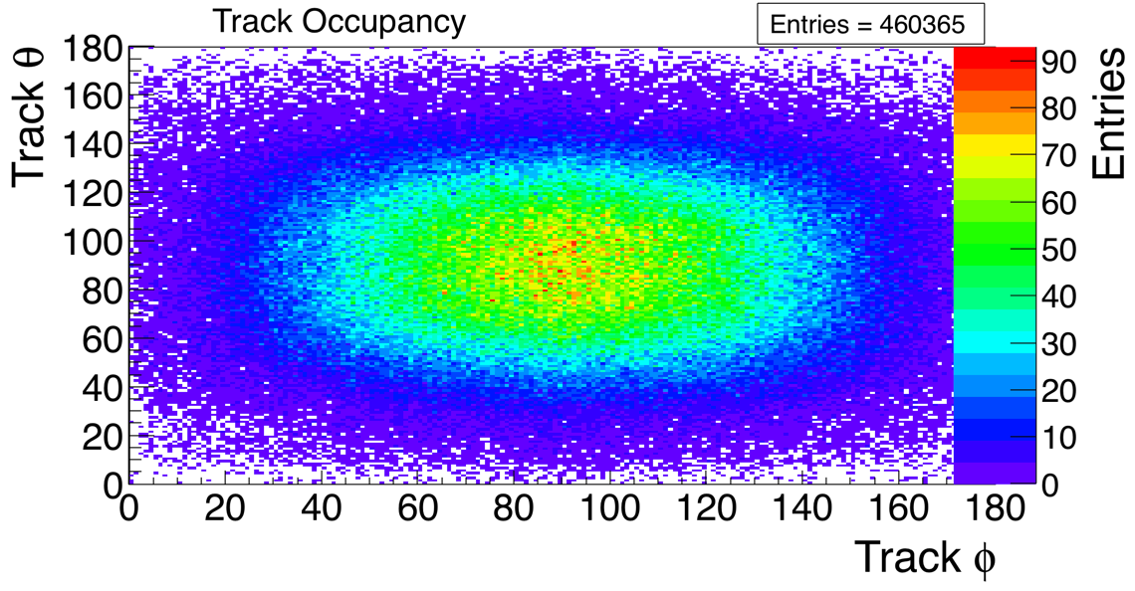
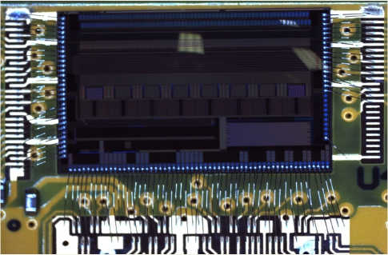
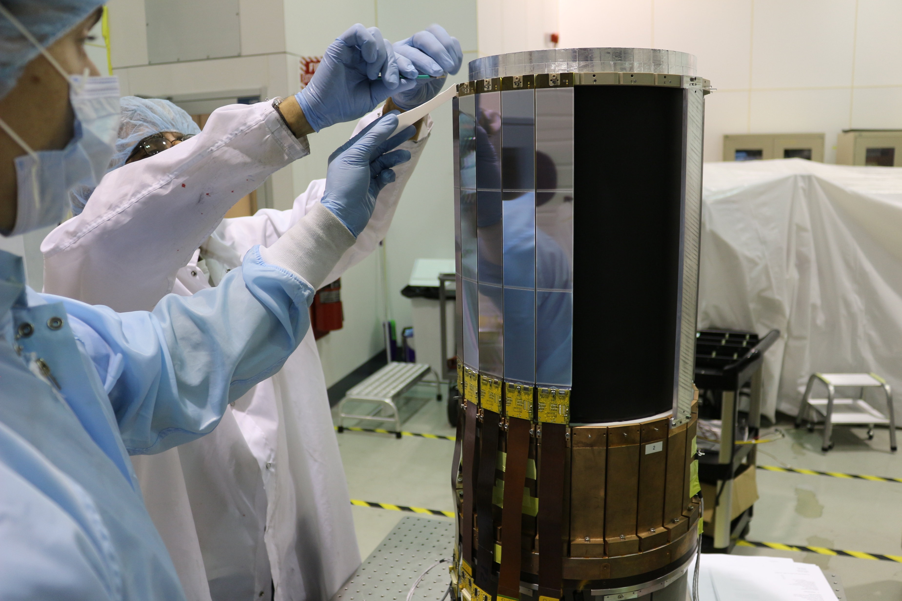
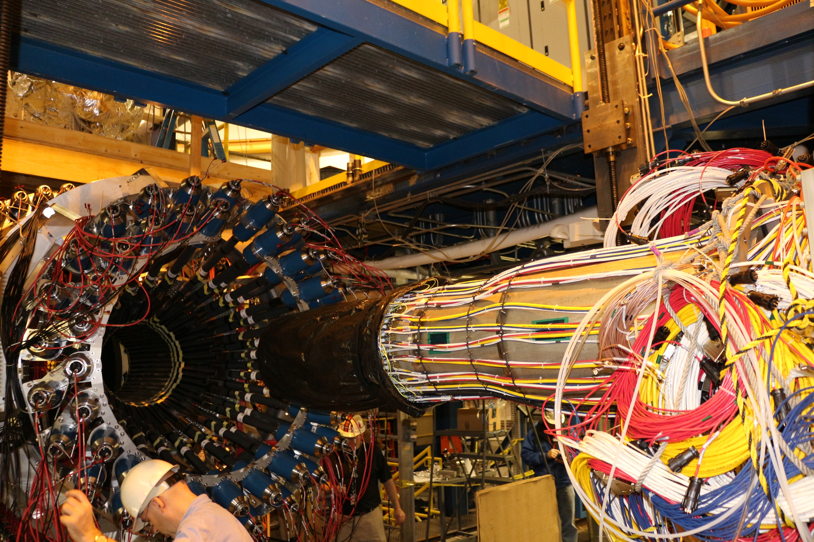
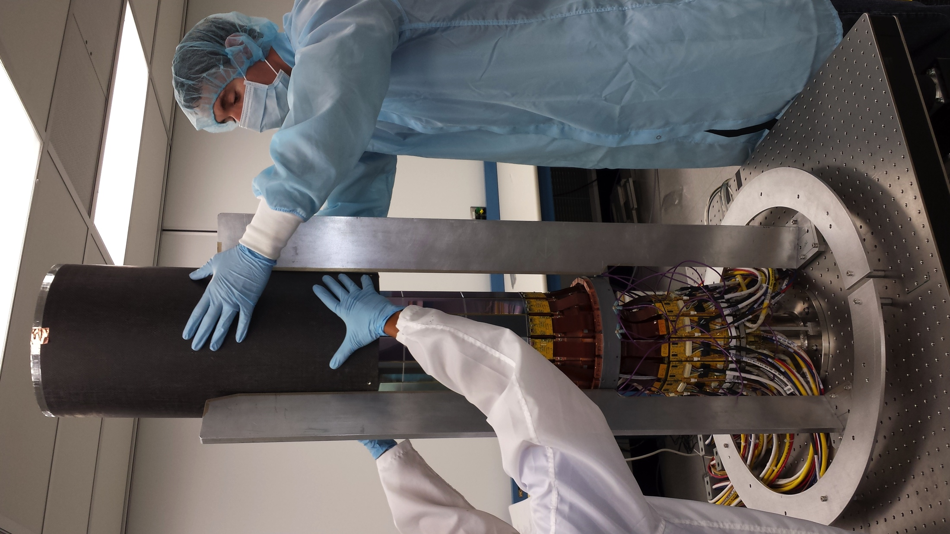
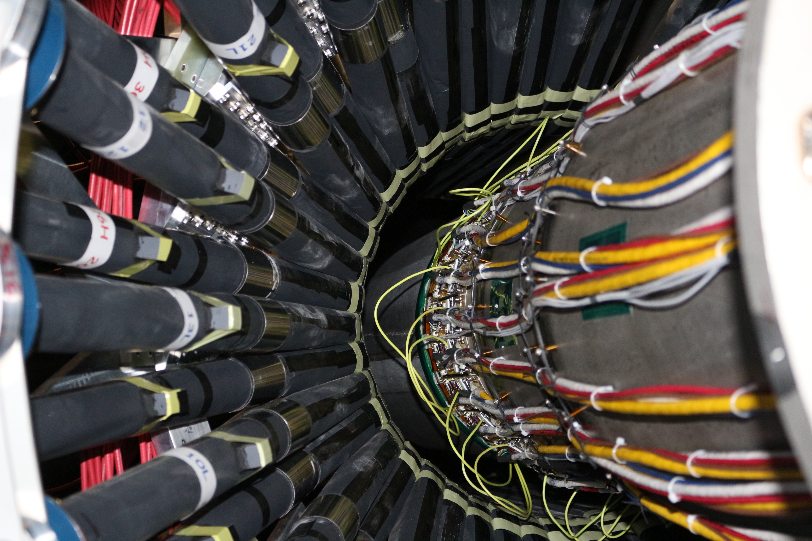
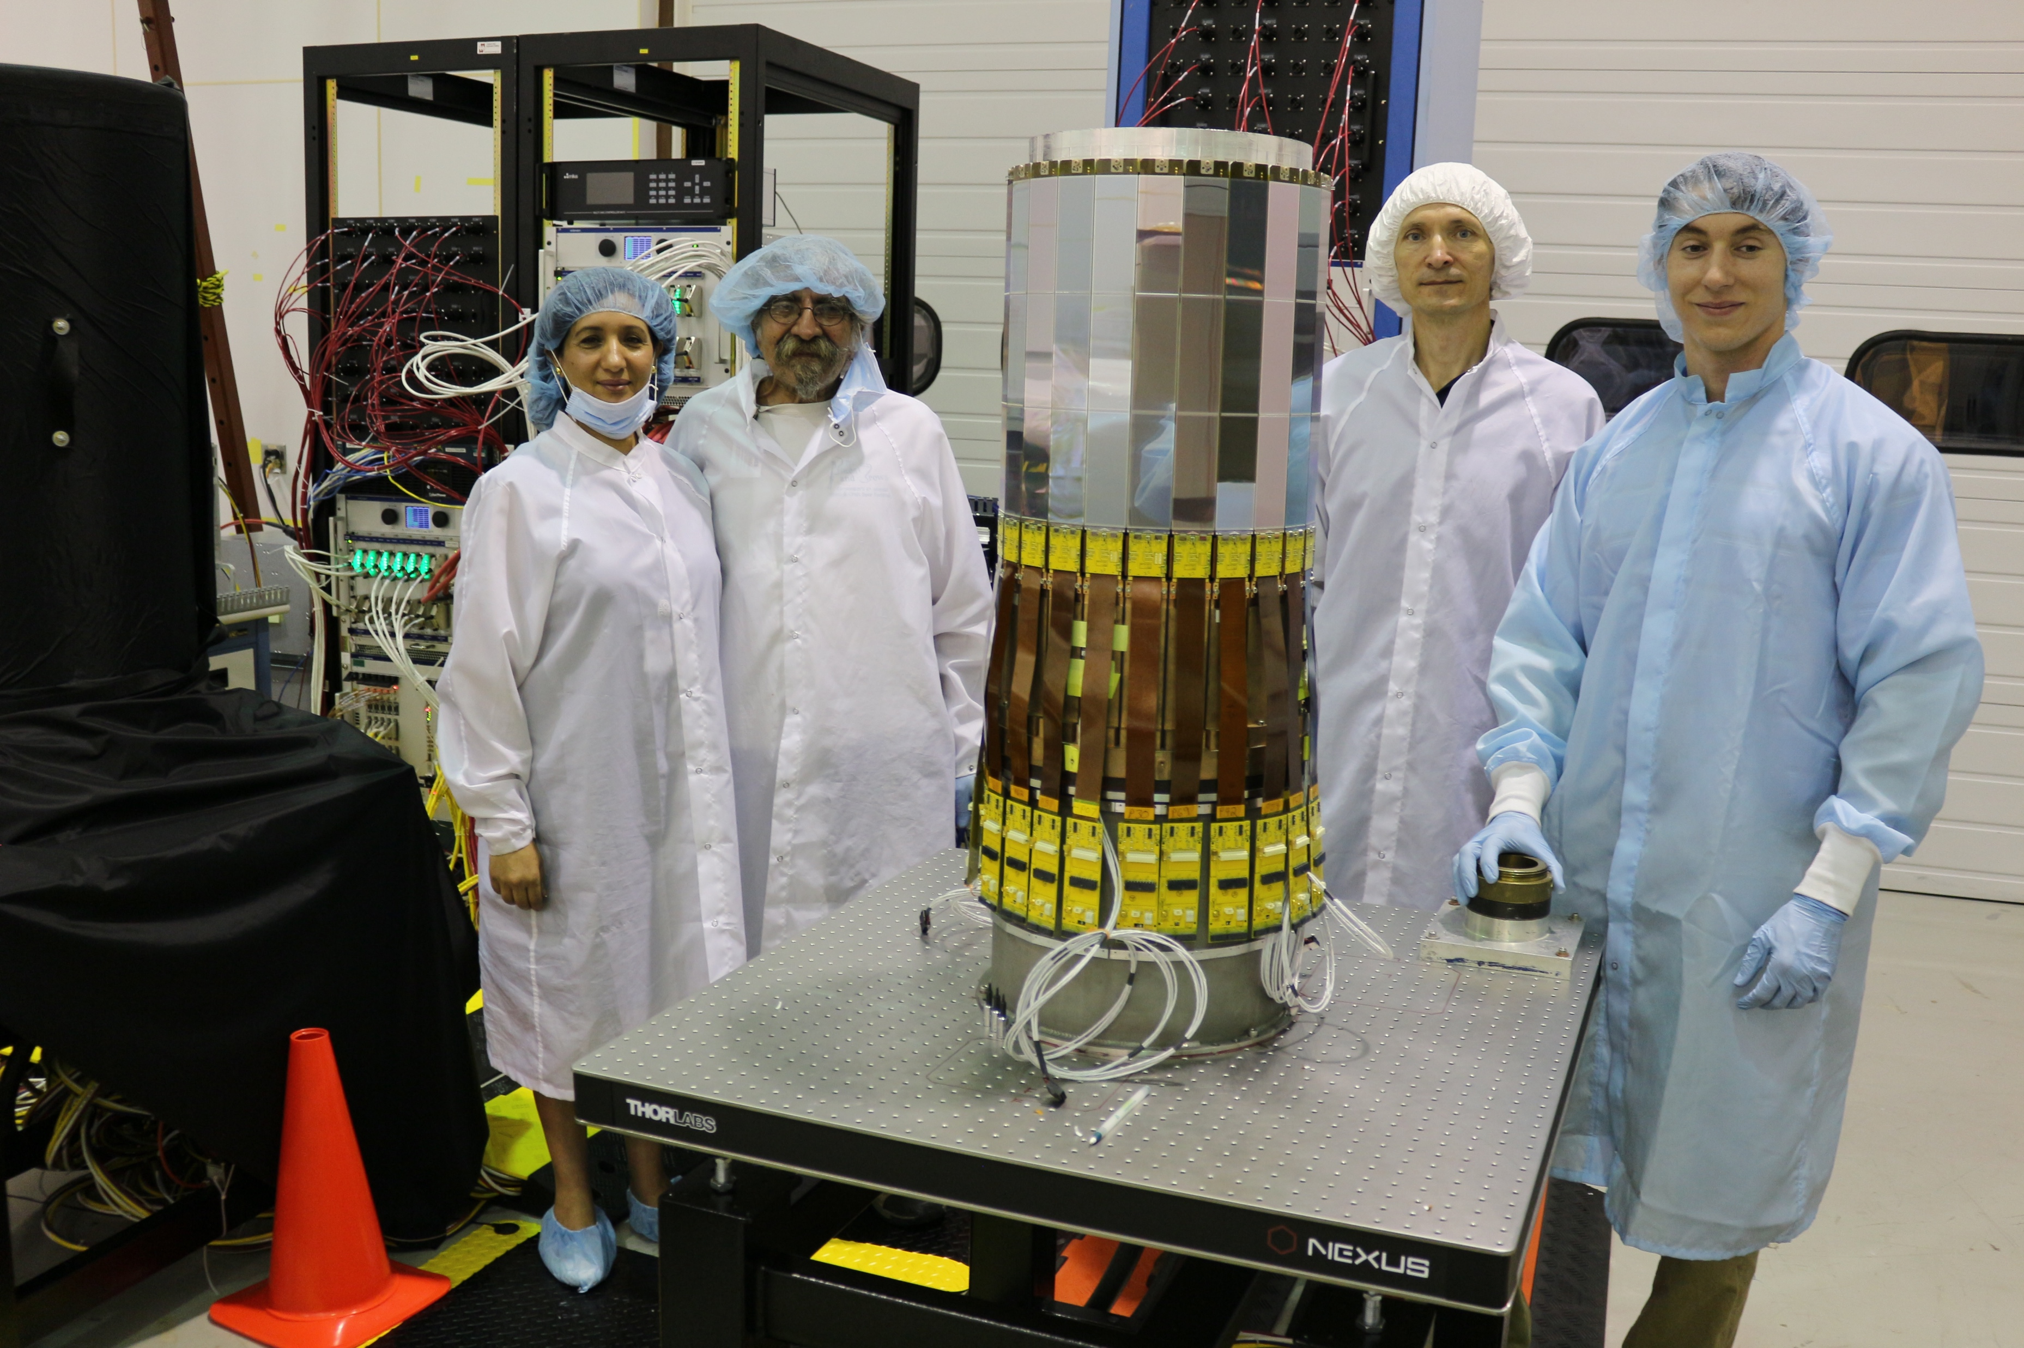
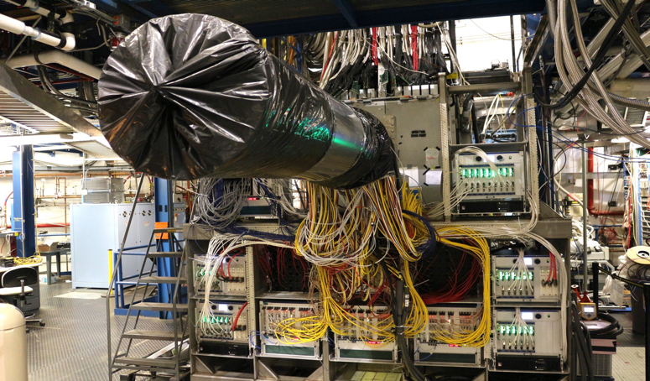
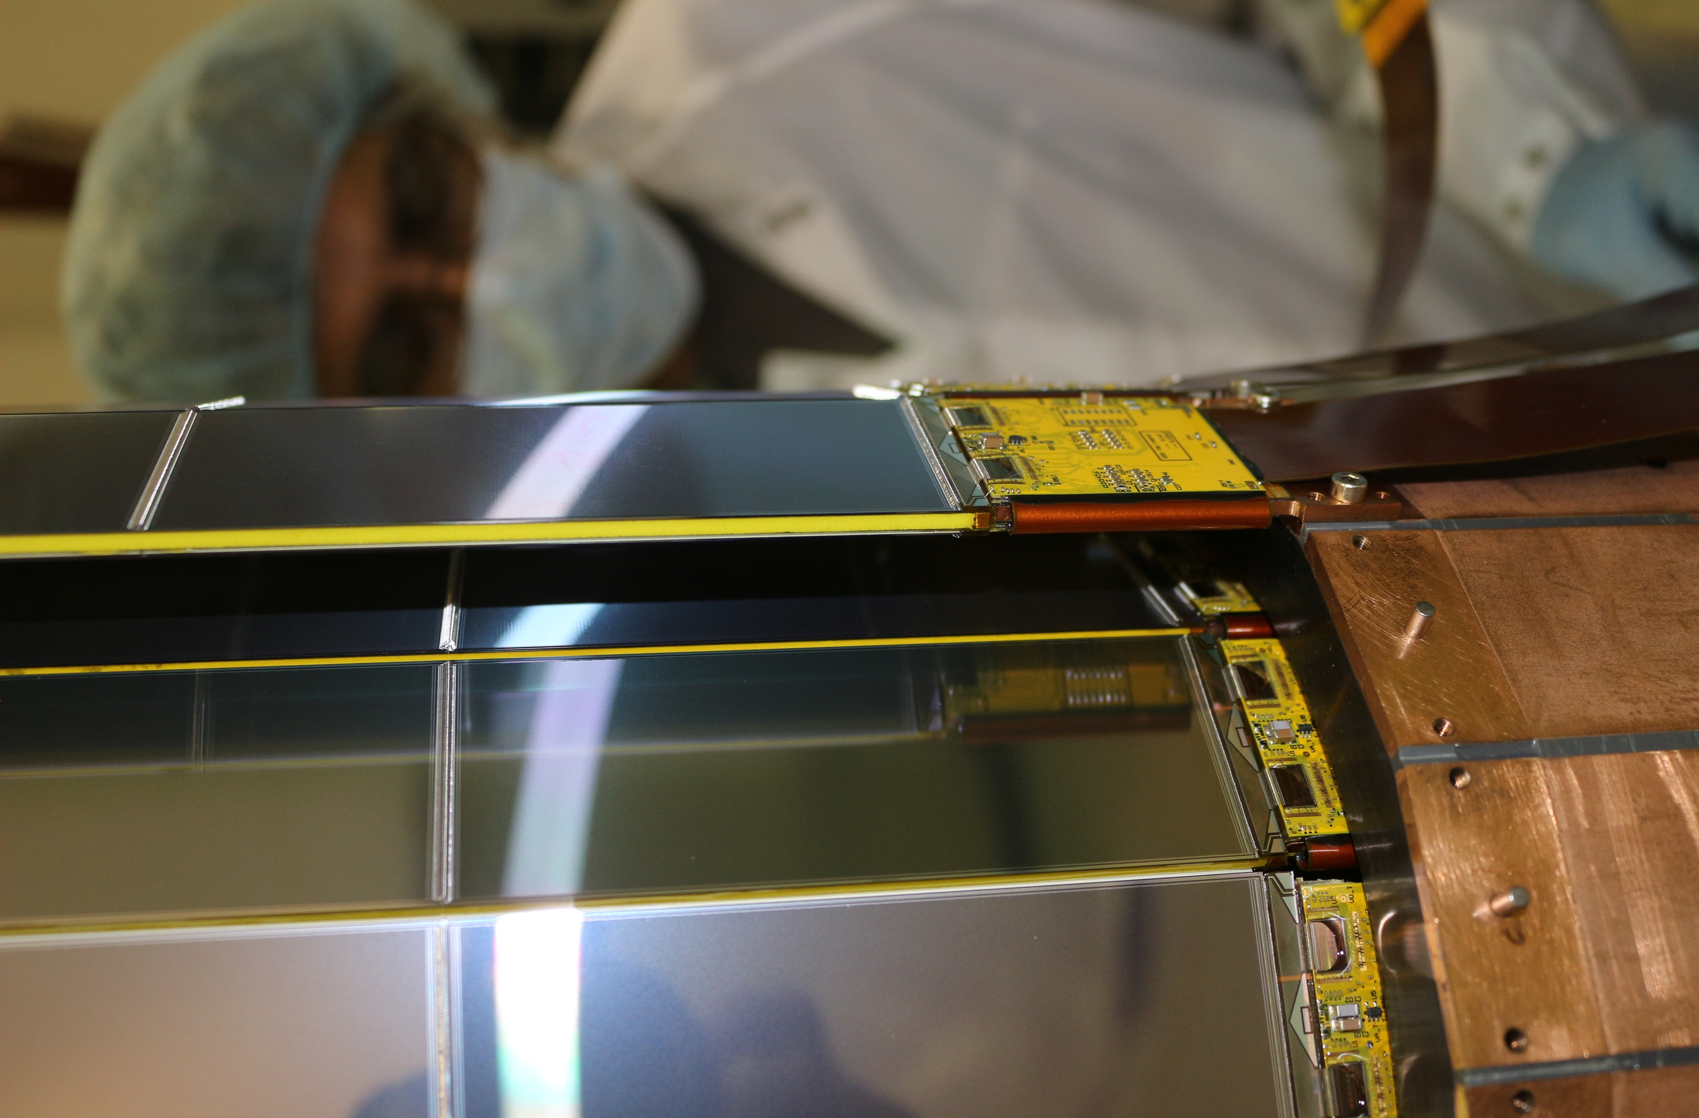
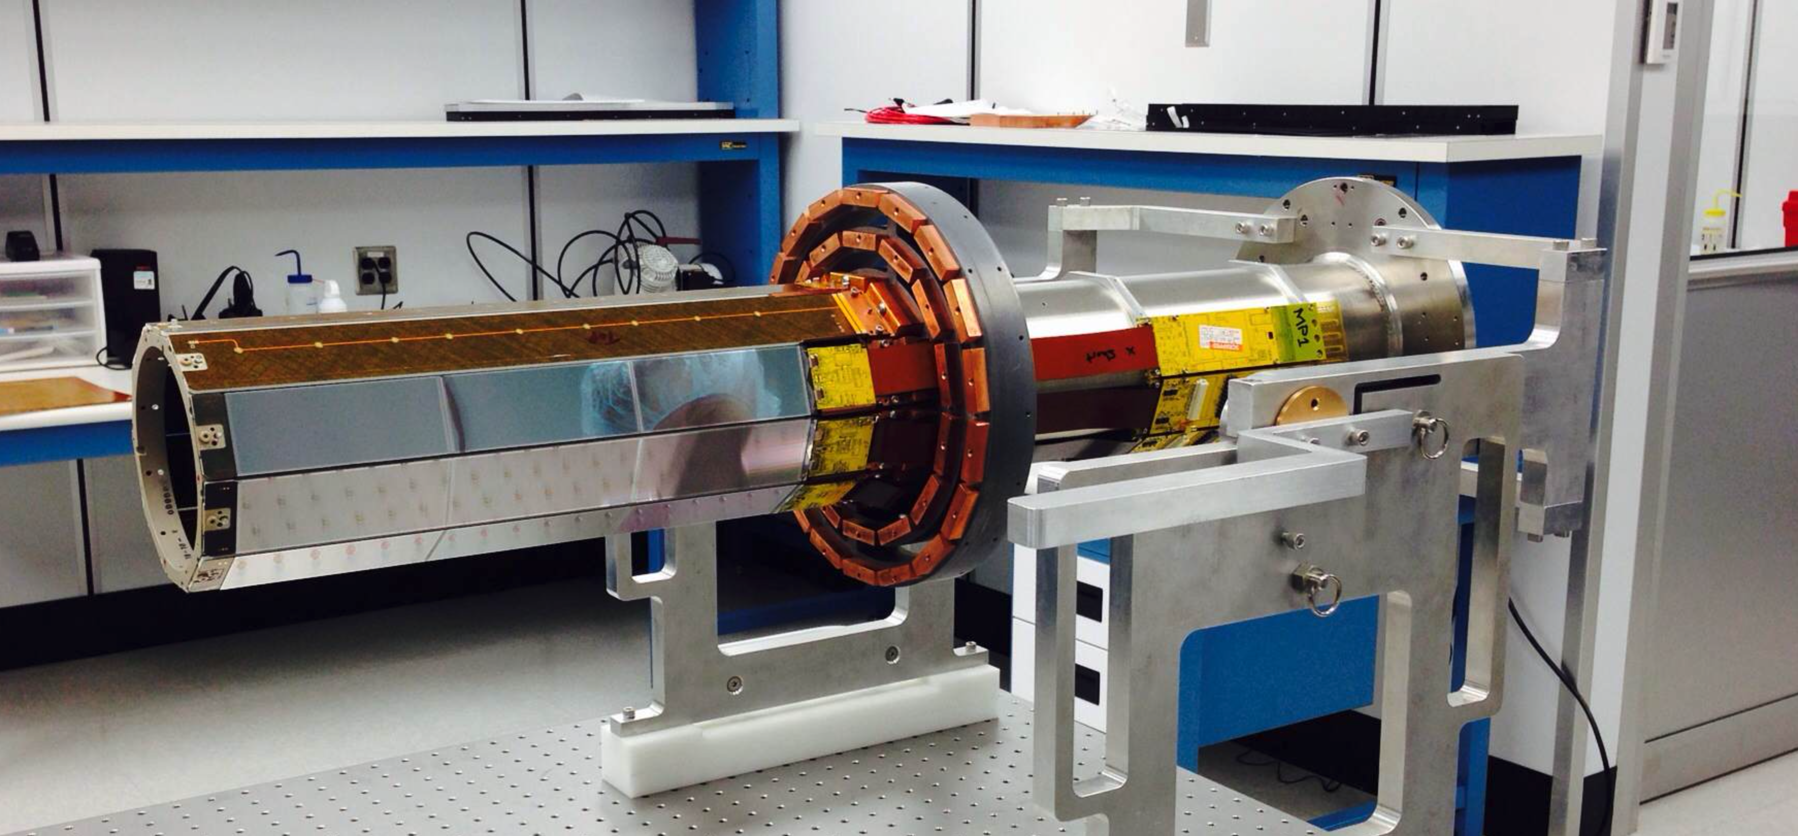
Silicon Vertex Tracker (SVT)
Thomas Jefferson National Accelerator Facility
What is it?
SVT In Action
The Silicon Vertex Tracker is used to determine:
The location of the nuclear collision generating the particles
The angle and direction of the particles
The momentum of the particles
When particles cross the silicon layers, they release a fraction of their energy. We call this process a “hit”. These hits are detected by 21504 charge sensitive cells. Each cell (we call them “strips” because they are long and thin) records the position of the cross and deposited energy.
Dedicated software used to process all the hit positions and ”reconstruct” the properties of the particle, like its charge and momentum.
A representation of a single collision recorded in April 2018.
We collect about 10000 of these events every second.
You can see the particles hitting various detectors, including the SVT (3 innermost double sided layers).
The “clockwise tracks “ are positively charged particles. The counterclockwise are negatively charged particles. In this event there is a proton, 2 positive pions, and one negative pion.
Below is the same event, seen from the side.
Our computer simulation of a proton and a pion hitting the the SVT. Each particle produces 6 hits: one for each SVT layer. The object at the center is the target, located along the electron beam axis.
The layout of one SVT module. The strips run along all 3 sensors. Their electronic signals are transferred by the circuit board.
Tech Specs
21504 channels in six layers
3 concentric double-sided regions
Sensor thickness 320 𝝁m
Strip length up to 33 cm
128 channels / readout chip
Data rate ~ 200 Mbits / s
Data readout clock: 70 MHz
Power consumption < 4 mW / channel
Radiation hard design
State-of-the-art 15-layer rigid-flex double sided hybrid
Low material budget
Operation in 5 Tesla magnetic field
Tracking efficiency > 90 %
Momentum resolution : δpT/pT < 5%
Angular resolution:
Polar δΘ < 10 - 20 mrad,
Azimuthal δΦ ~5 mrad
Silicon Readout Chip
Equivalent noise charge of the SVT channels. JLab scientists worked very hard to minimize this noise: the JLab SVT is the best in the world in its class.
Angular distribution of cosmic rays. We used muons generated from stars and supernovas to calibrate the SVT.
Building and Installing the SVT
Did you know?
The Silicon Vertex Tracker is built to operate in high magnetic field, (about 12 times stronger than what can erase credit cards, damage peacemakers, etc).
The SVT contains 21504 strips, each connected to an electronic channel. The strips have a width smaller than the diameter of a human hair, and are up to 13 inches long.
The JLab electronics is capable of reading the 21504 SVT channels 70 million times / second. All at the same time!
The whole sensitive area of the tracker must be very light so it doesn’t slow down the particles. A full module, containing 512 strips, weights less than two ounces.
Best in class: Silicon Trackers are rarely this big because of electronic noise problems. JLab SVT performs like a much smaller size tracker, making it the best in the world of this size.
The SVT, all cabled up, is about to be inserted in the Central Time-Of-Flight system. The placement was successful thanks to a high precision alignment system designed by JLab’s engineers.
Installing the Faraday cage cover to ensure shielding of the sensors from external noise.
Region 3 assembly. The building and assembling of the detector took place in a special clean room with HEPA filtering of dust particles to protect the silicon modules.
The SVT in it’s new home surrounding the target and being surrounded by the micromegas and the time of flight.
Testing all 21504 channels!
A baby being born! This is region 1 of the SVT, the innermost.
Contributing Institutions
Jefferson Lab, Newport News, VA, USA
Fermilab, Batavia, IL, USA
Close up of the last layer of silicon
Enjoying the end of the construction of SVT. From left to right: Latifa Elouadrhiri, Steve Christo, Yuri Gotra, Brandon Marzolf

